Slide 1

Information Retrieval
Natural Language Processing
Sathish Rajendiran

Slide 2


To organize world's information, making it universally accessible and useful. -Google

Slide 3



Slide 4
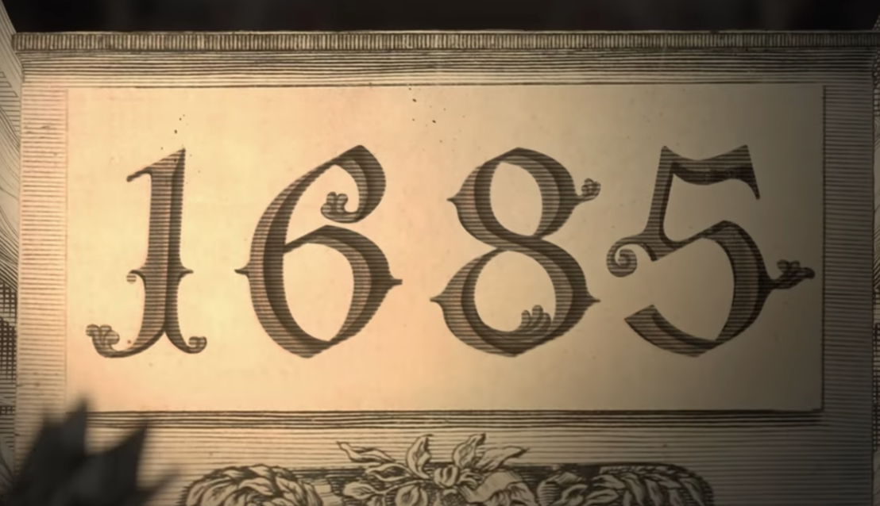

Slide 5
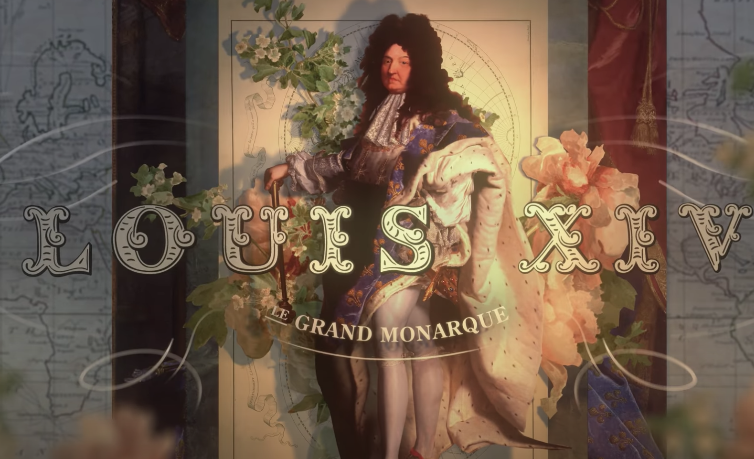
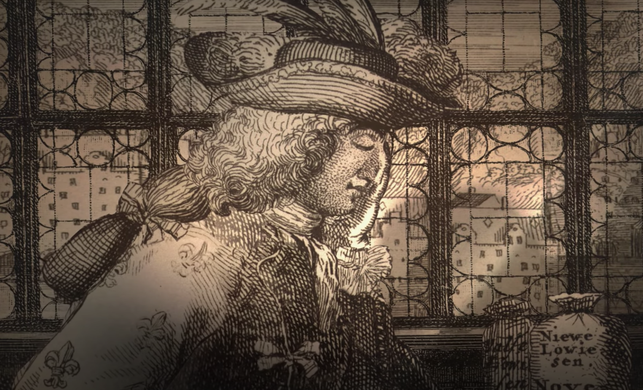

Slide 6
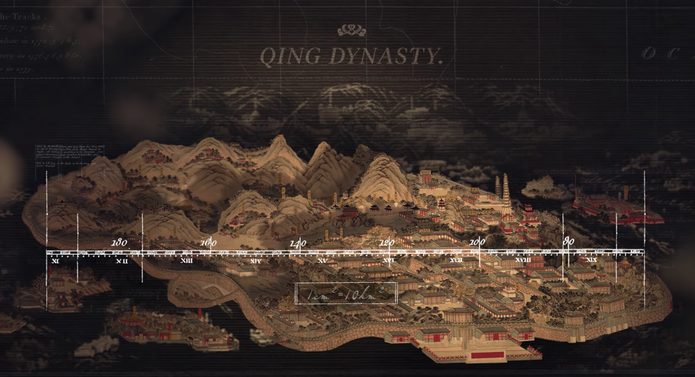
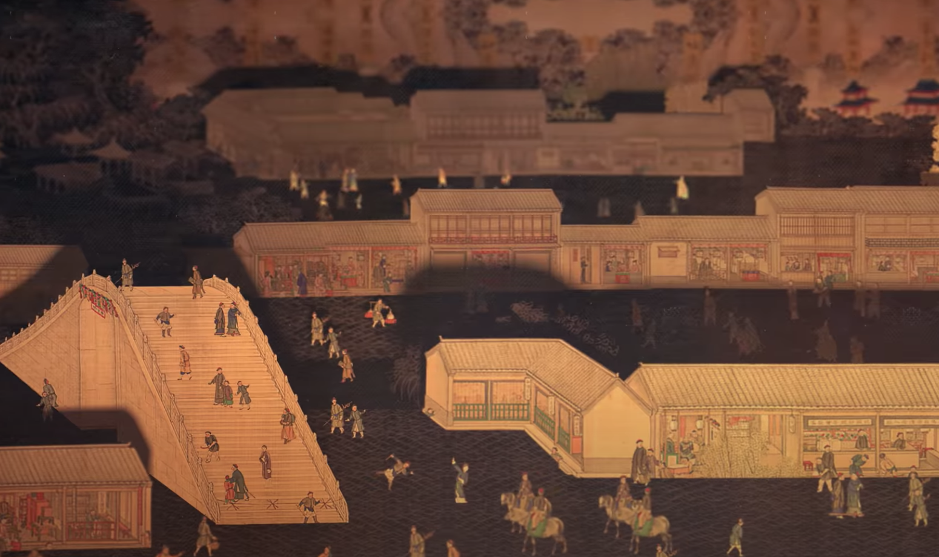
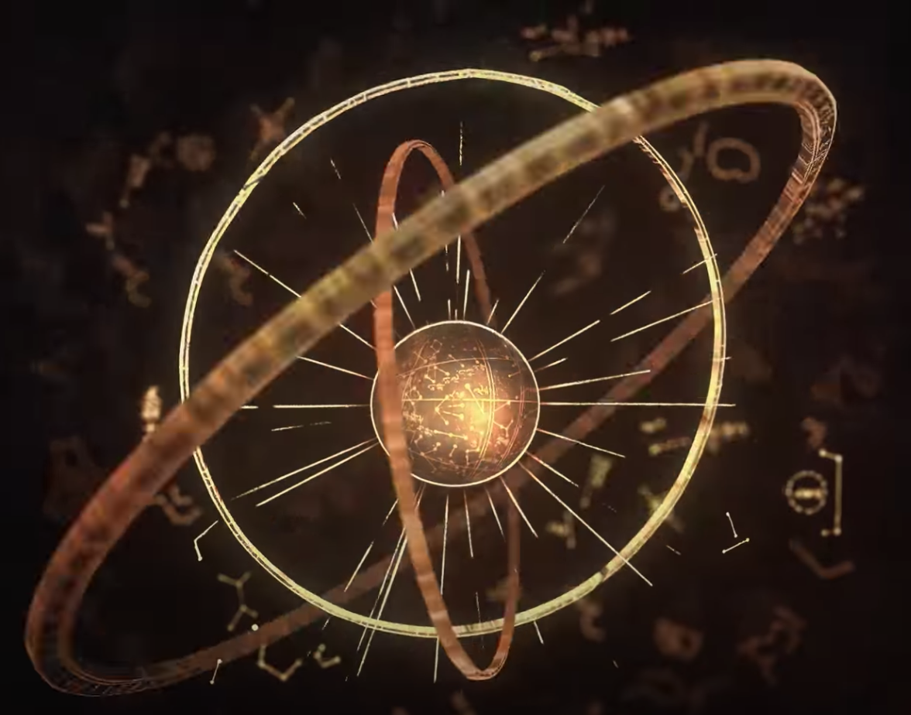
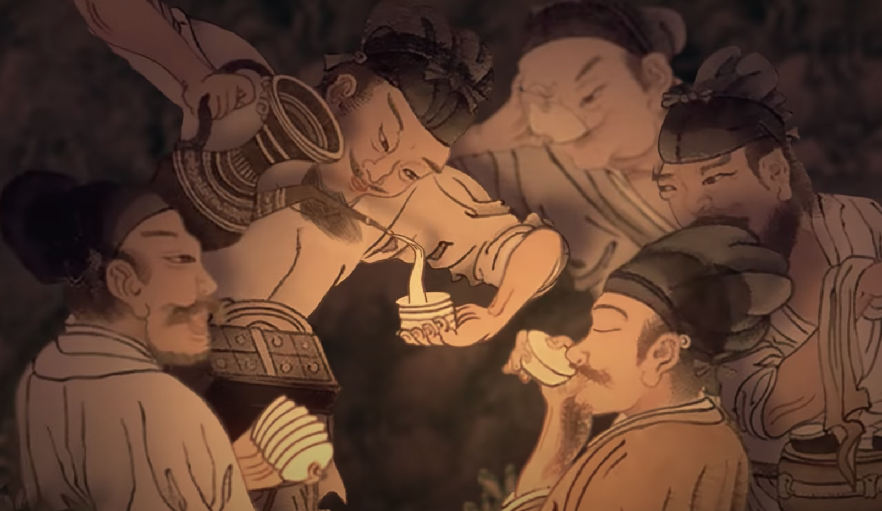
How big is it?
Population?
Culture?
Astronomy?
Music?
and more!

Slide 7

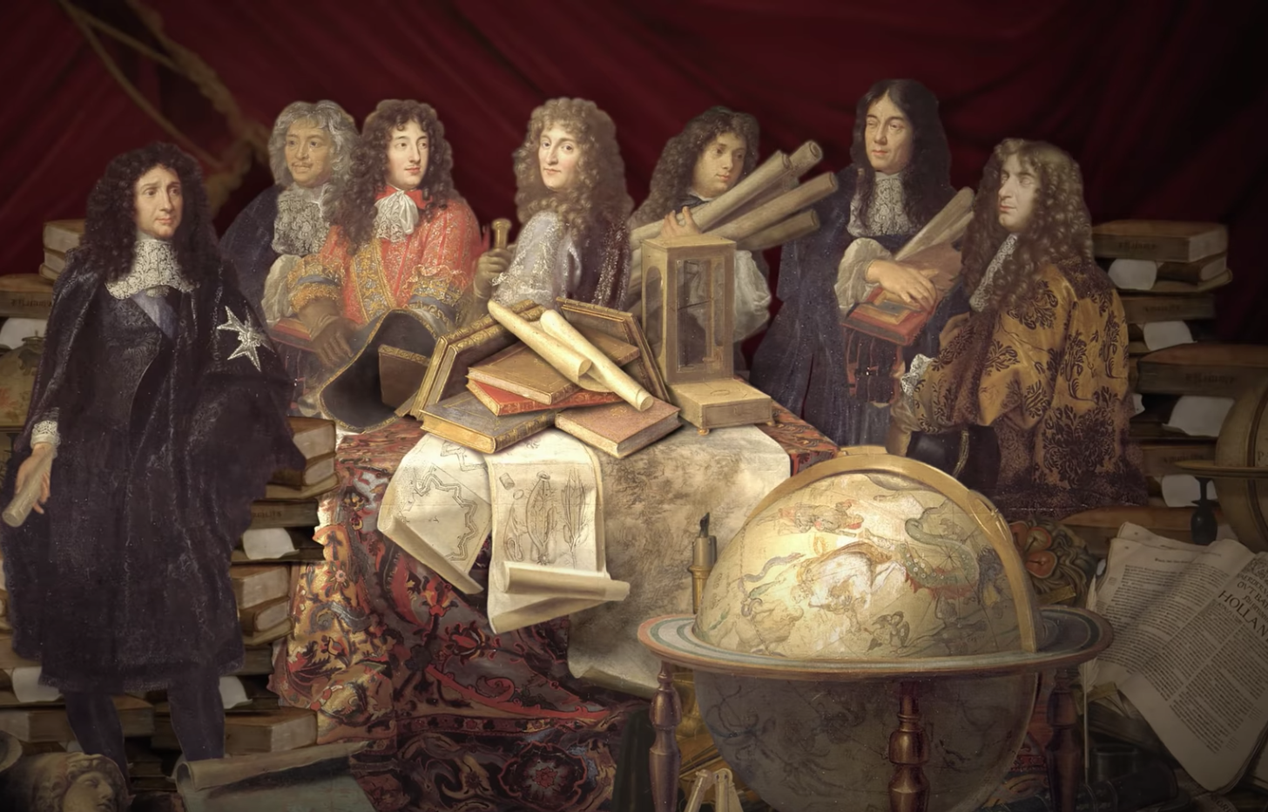

Slide 8
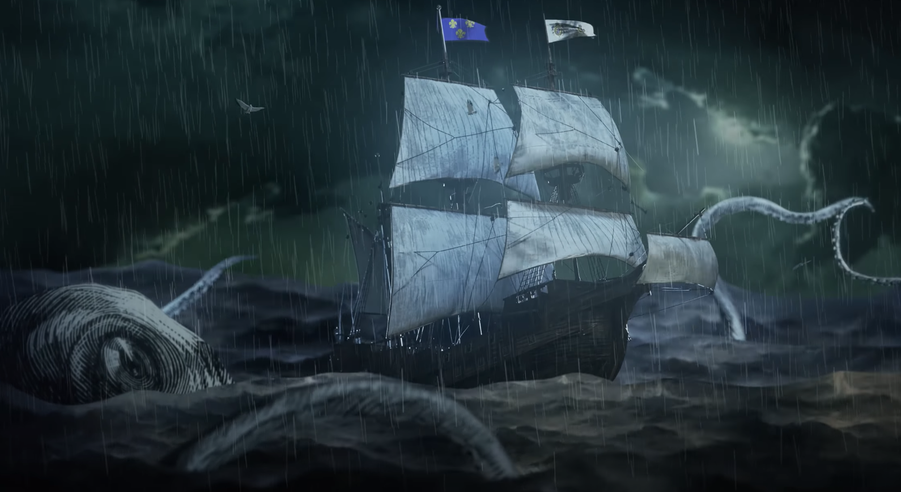
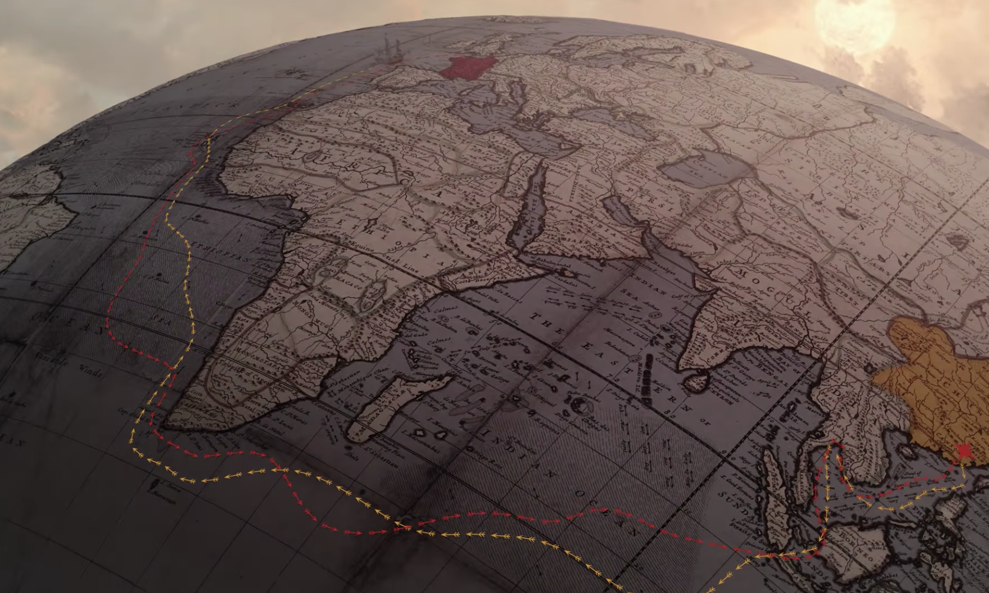
5 Years, 4 months and
2 days
Voyage spanning 3 continents , 3 oceans and against all odds

Slide 9
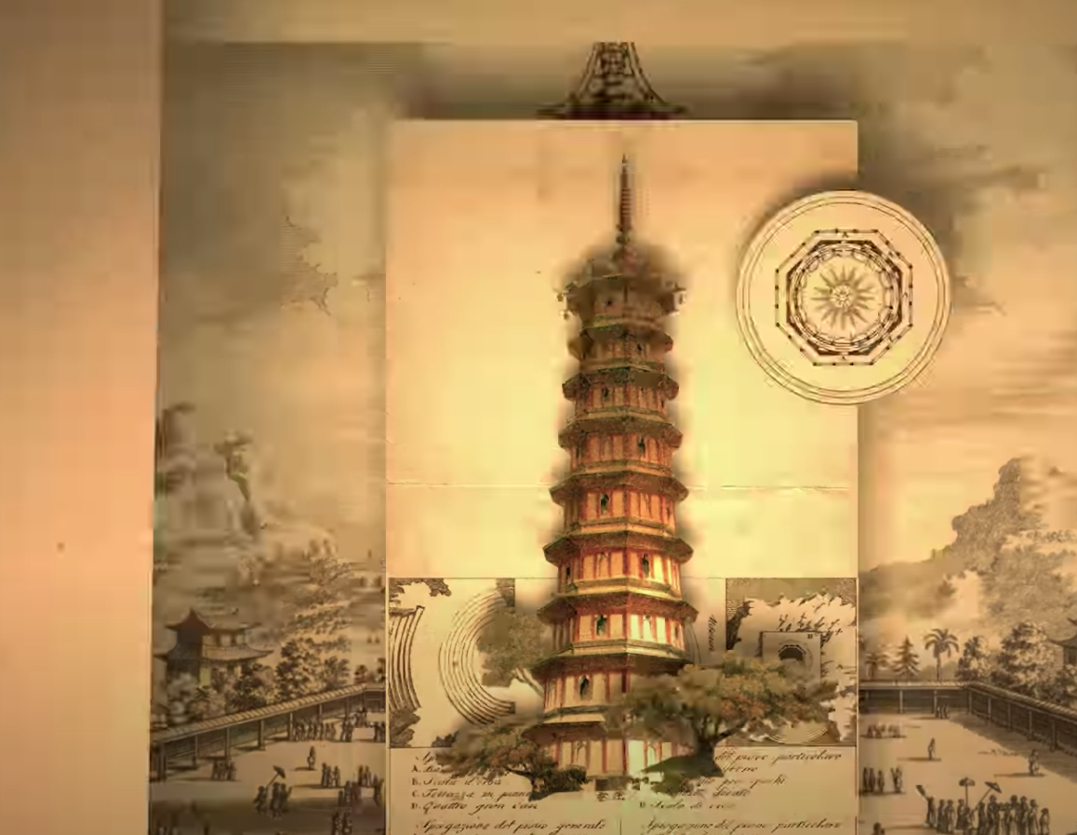
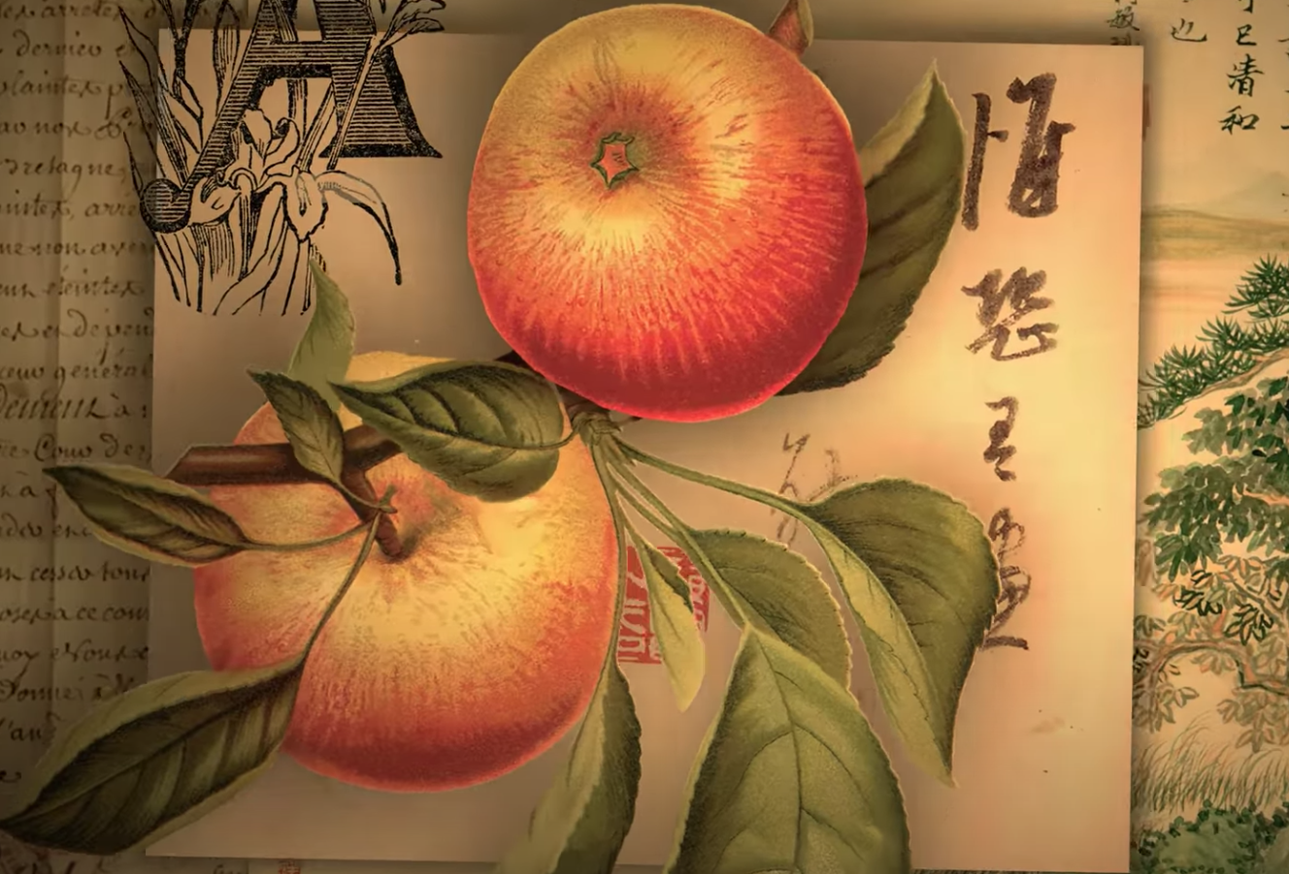
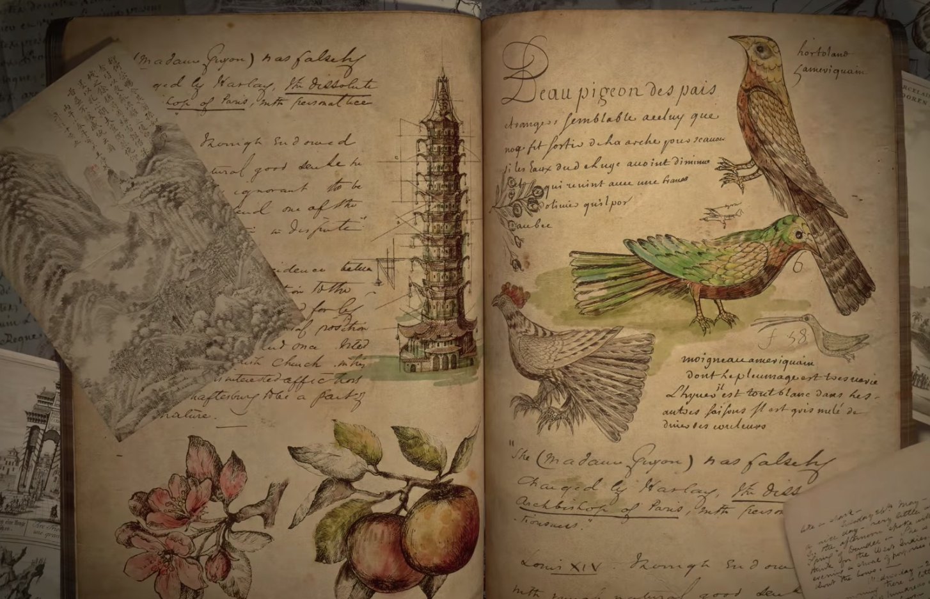
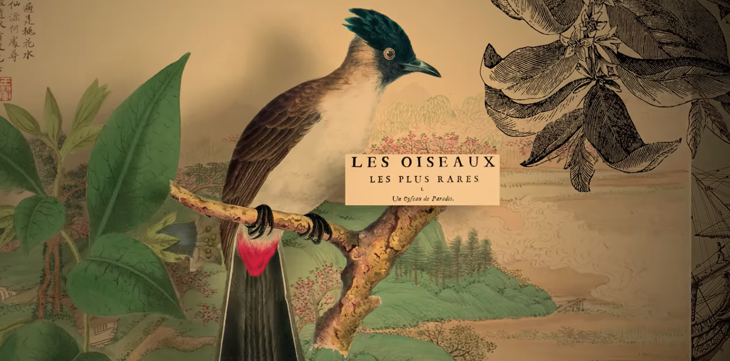
Information

Slide 10
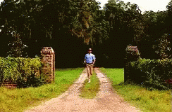

Slide 11


Slide 12
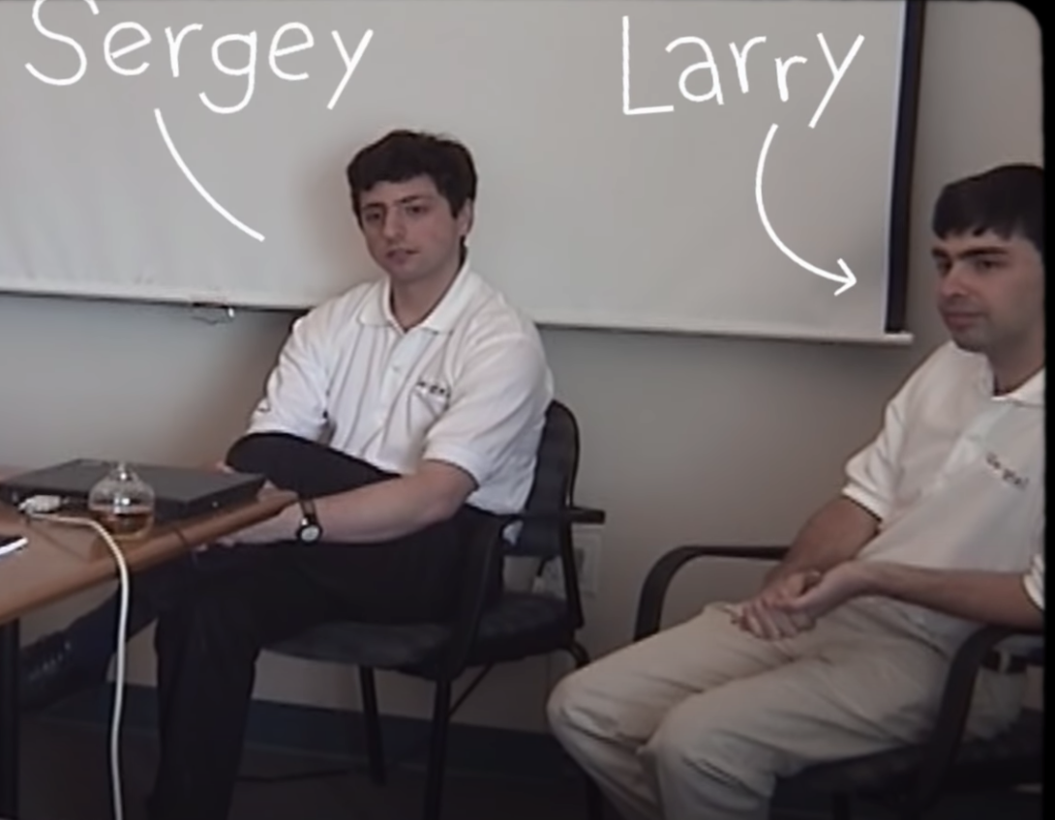

Slide 13
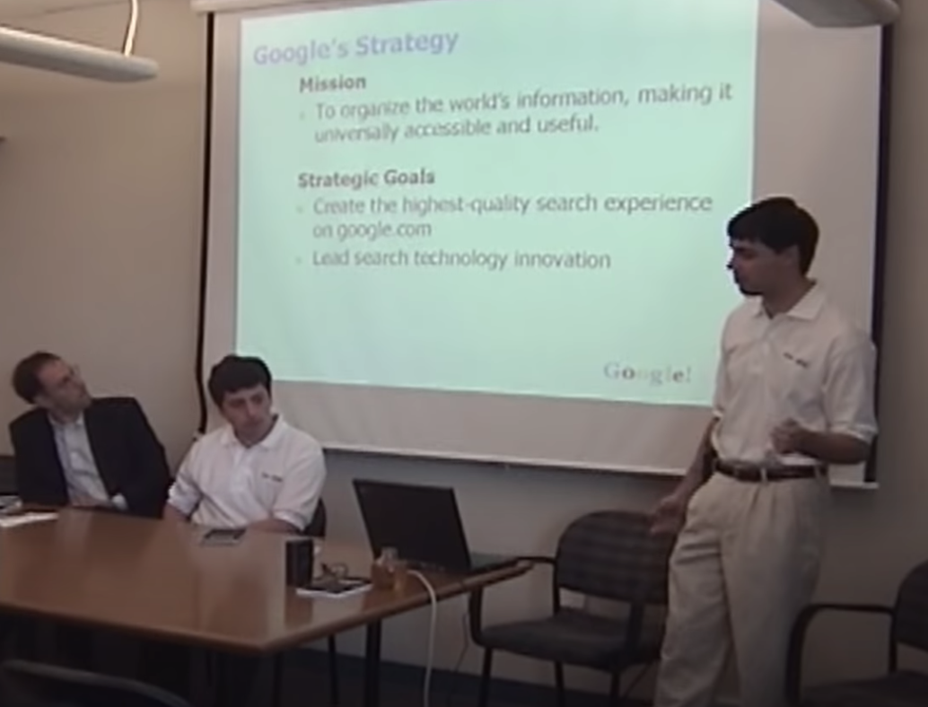

Slide 14
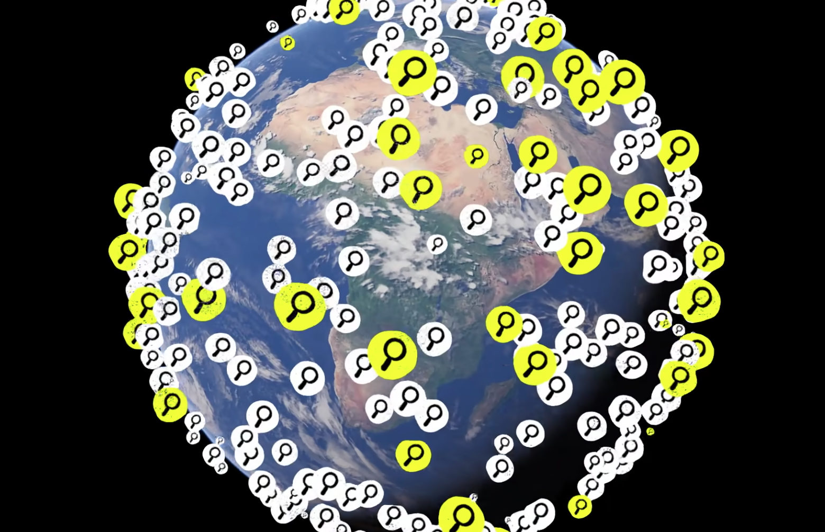
Web Search around the globe
1 in 7 search item - never searched before

Slide 15


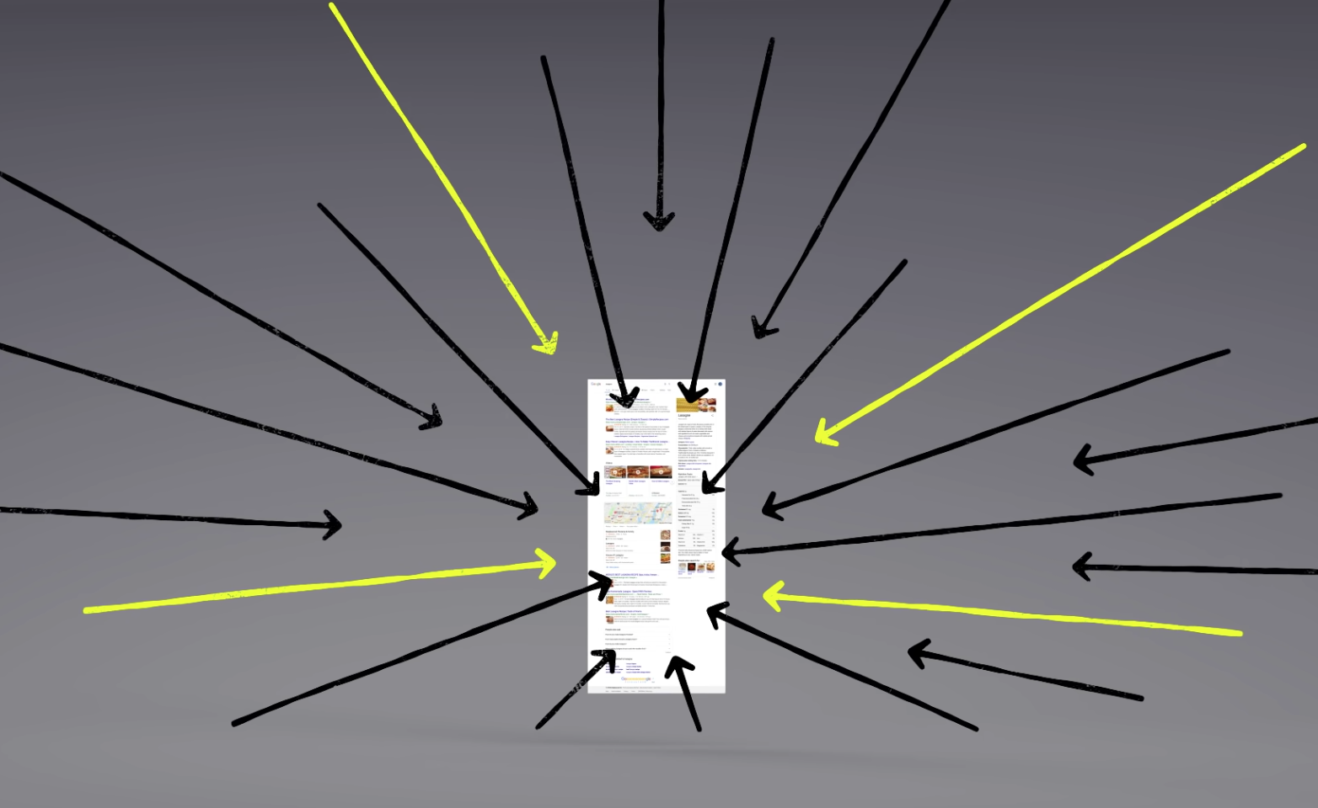
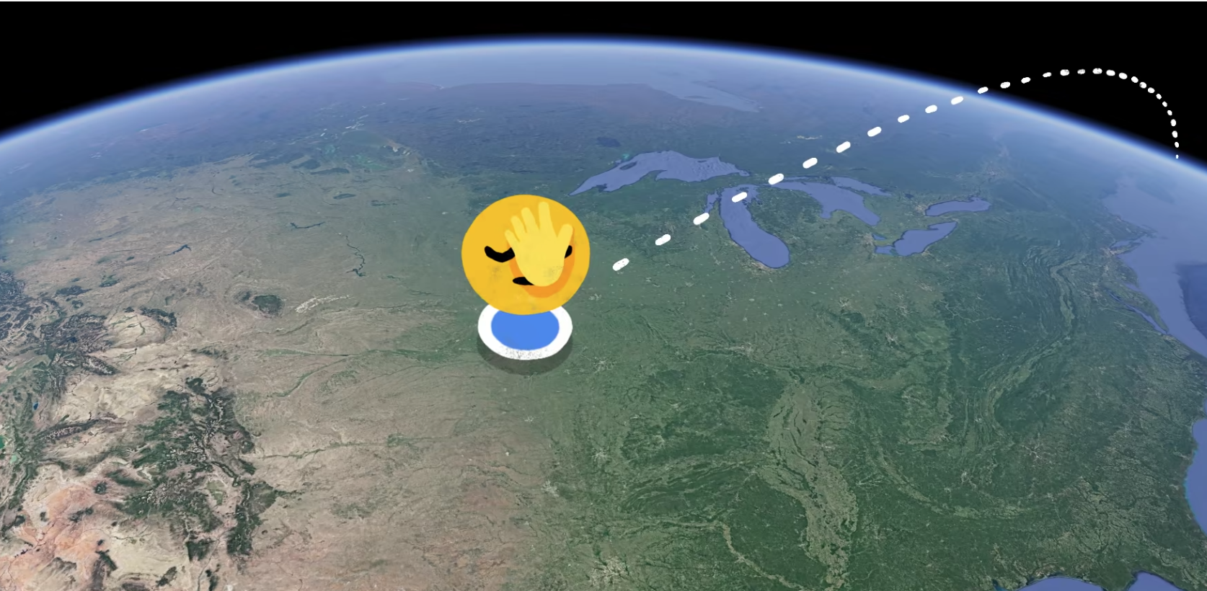
Keywords
Links
Location?
Freshness
and more!

Slide 16
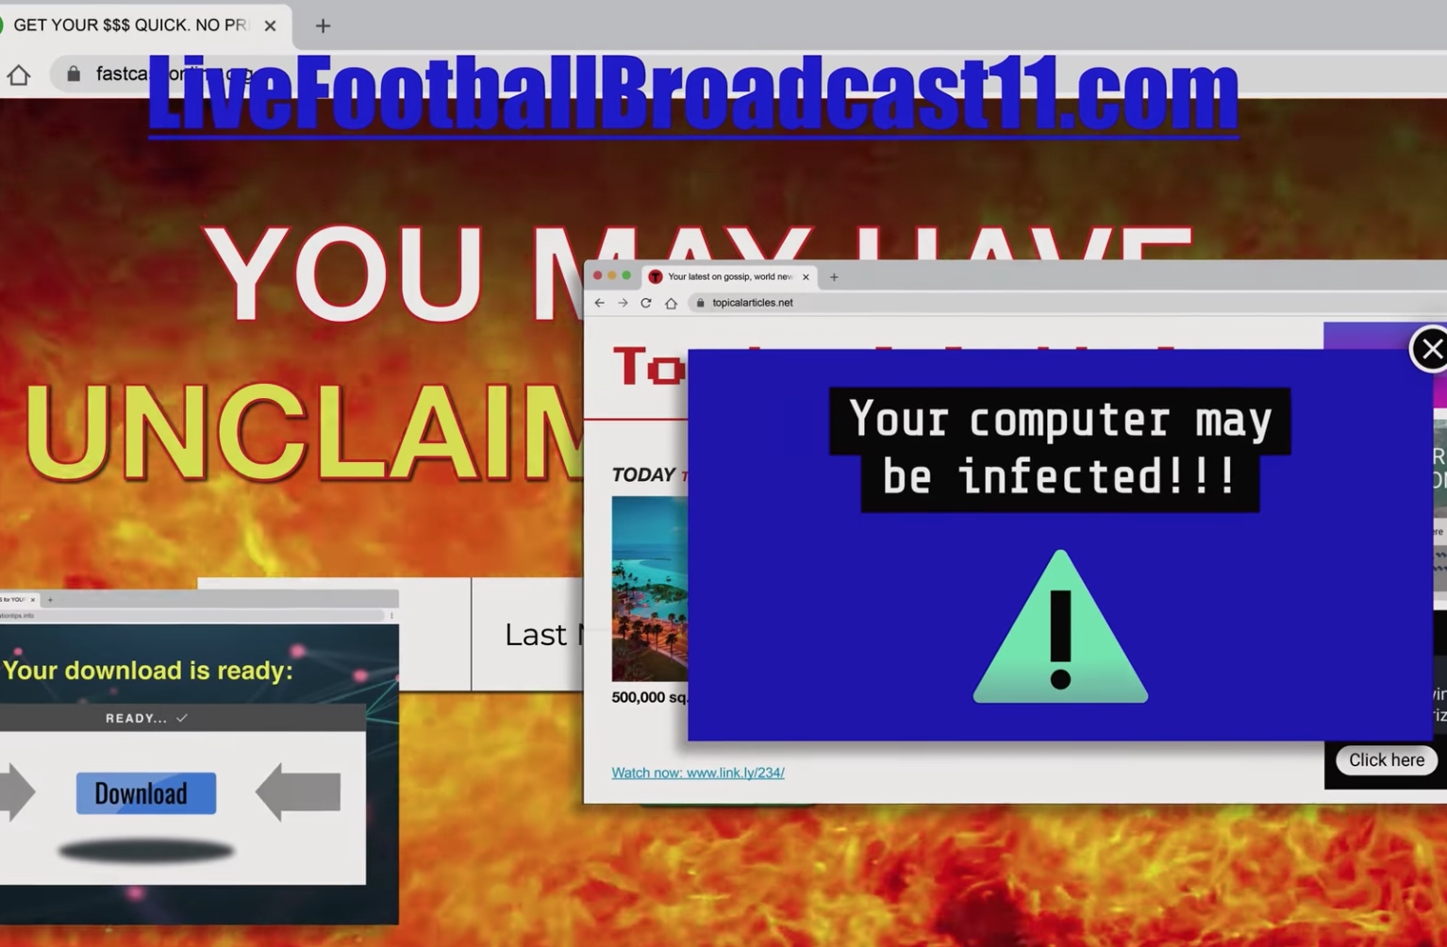


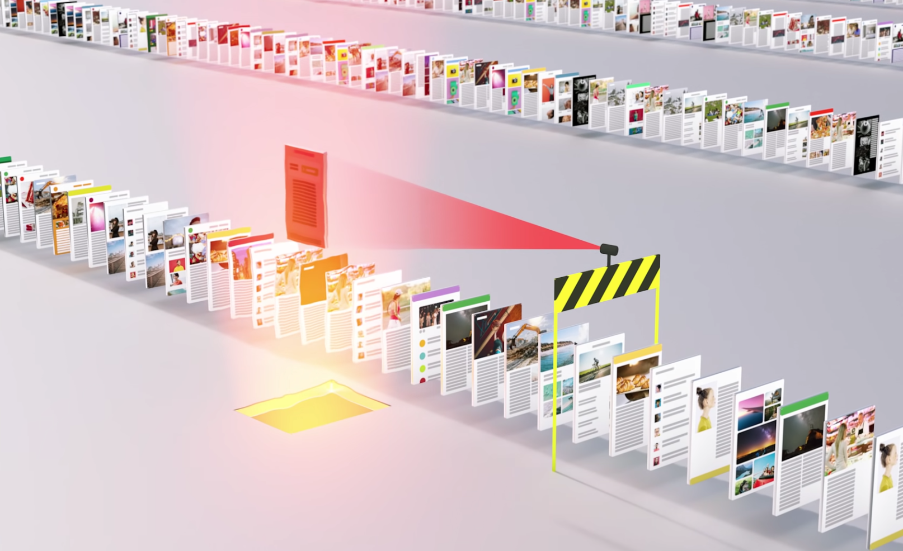
40% of the pages crawled last year were tagged as spams

Slide 17
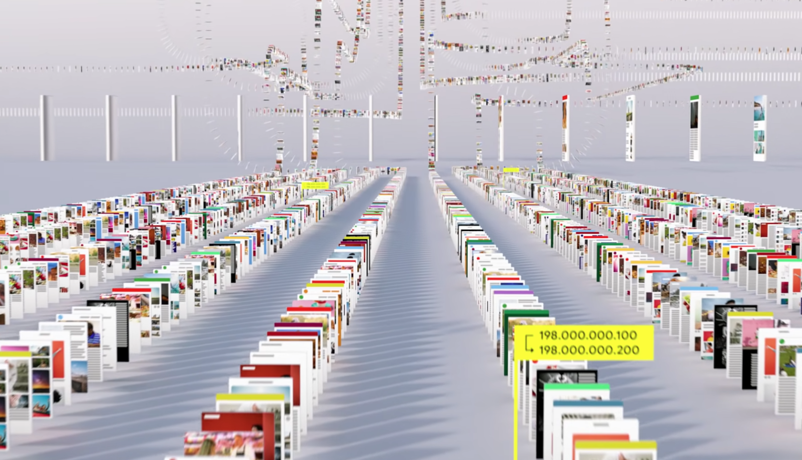
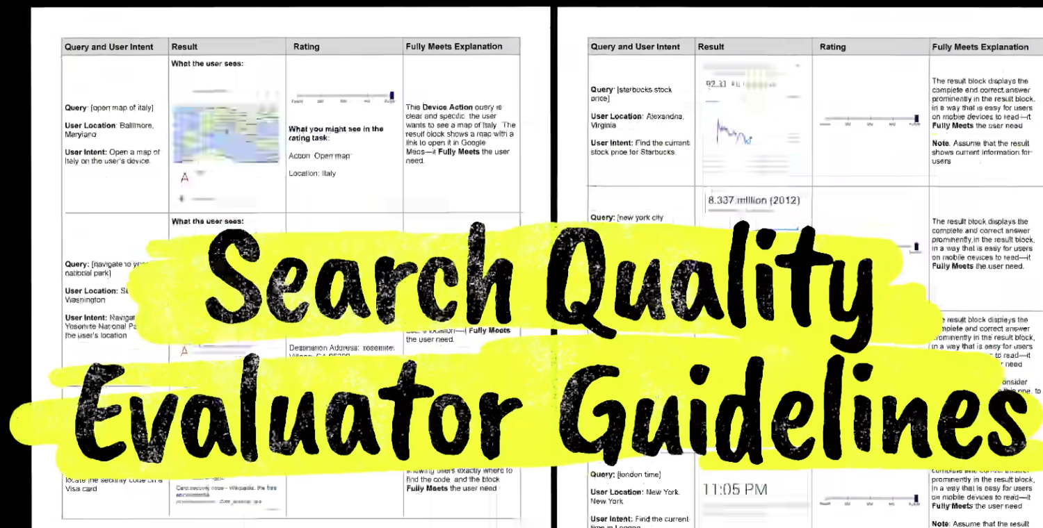
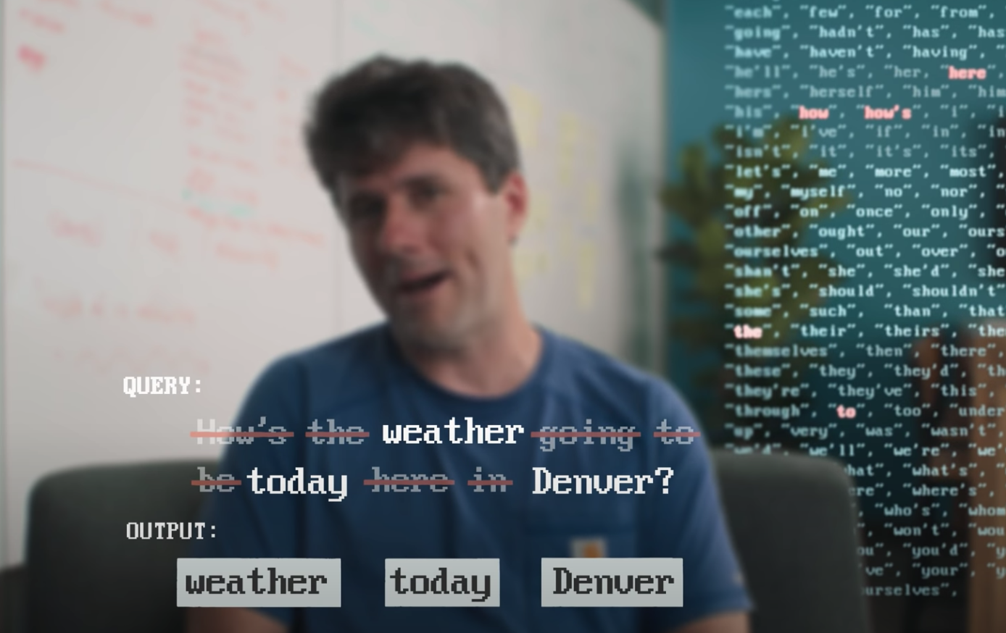
What makes a good quality search "good"?
Web crawling
Tokenizing
Flag Spams
Stopping the stop words
Normalisation
Stemming & lemmatization
Autocomplete
Ranks sites (Deep Ranking)
Indexes web
Custom Classifier algorithms
High Compute
Datacenters for search locations
Return results in fraction of seconds

Slide 18
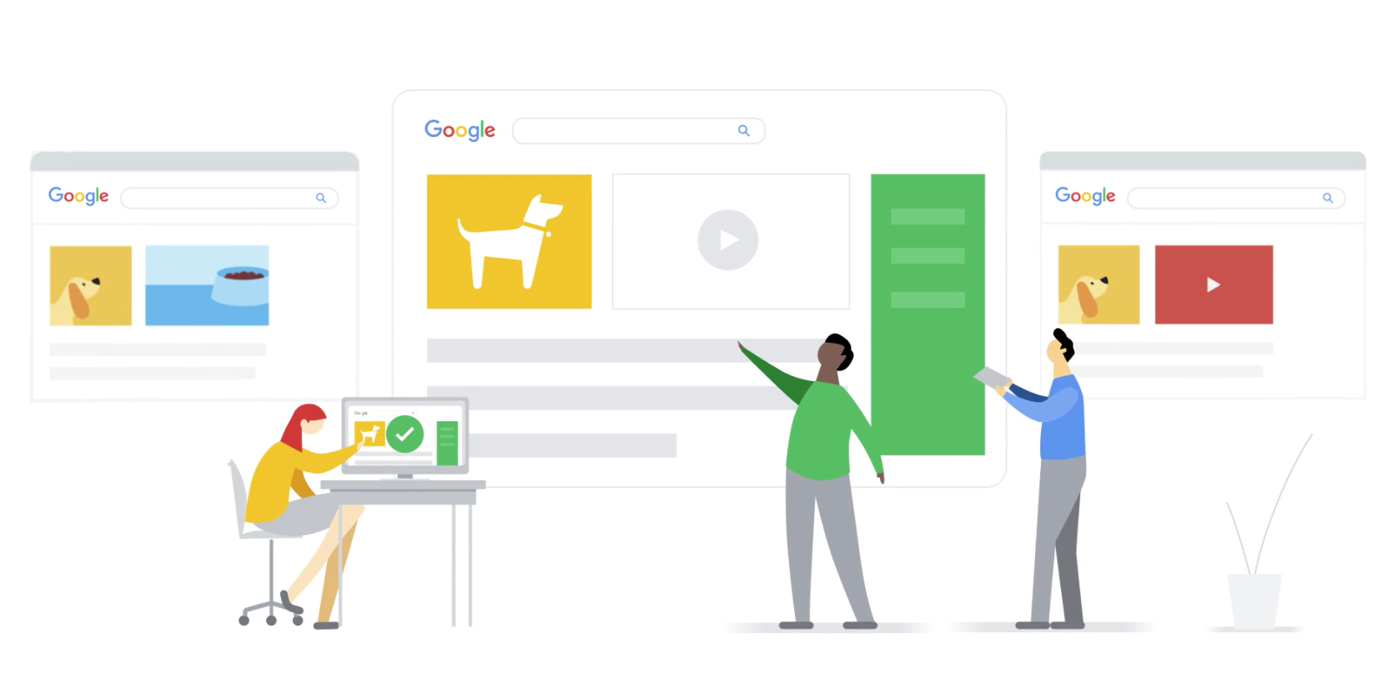
Always improving your experience

Slide 19
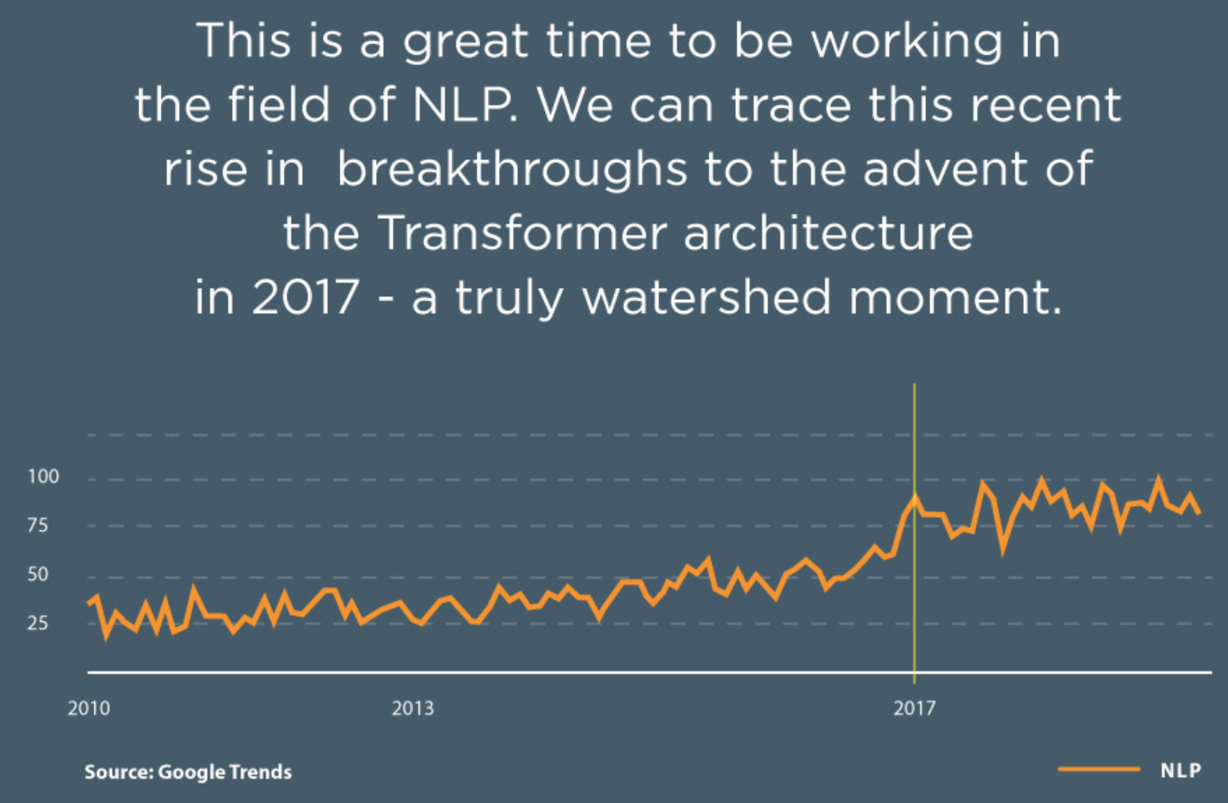

Slide 20
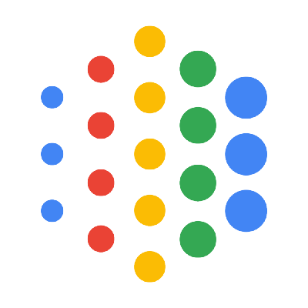
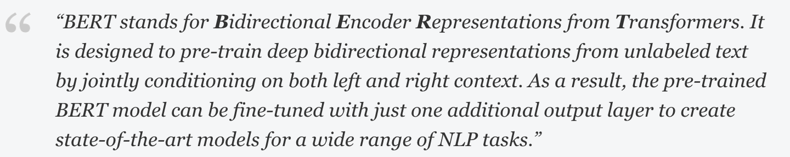

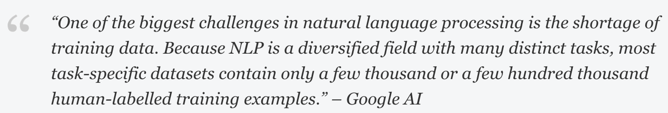
BERT
BERT is pre-trained on a large corpus of unlabeled text including the entire Wikipedia(that’s 2,500 million words!) and Book Corpus (800 million words)

Slide 21

How does it work?

Slide 22
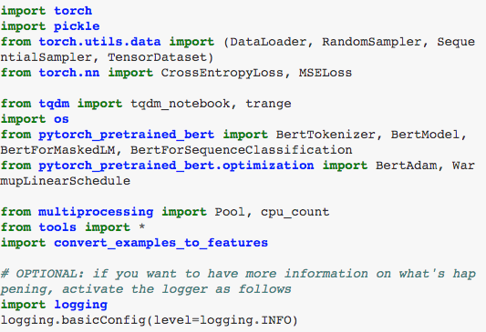
May I use it?

Slide 23
References
https://www.google.com/search/howsearchworks/
https://www.analyticsvidhya.com/blog/2020/07/top-10-applications-of-natural-language-processing-nlp/
https://www.youtube.com/watch?v=0eKVizvYSUQ
https://www.analyticsvidhya.com/blog/2019/09/demystifying-bert-groundbreaking-nlp-framework/
https://www.analyticsvidhya.com/blog/2019/08/complete-list-important-frameworks-nlp/?utm_source=blog&utm_medium=demystifying-bert-groundbreaking-nlp-framework
https://blog.google/products/search/search-language-understanding-bert
https://www.ukessays.com/essays/history/kangxi-and-louis-xiv-history-essay.php
https://en.wikipedia.org/wiki/Louis_XIV

Slide 24


